Slide 1
Move To
Functional Programming

Slide 2
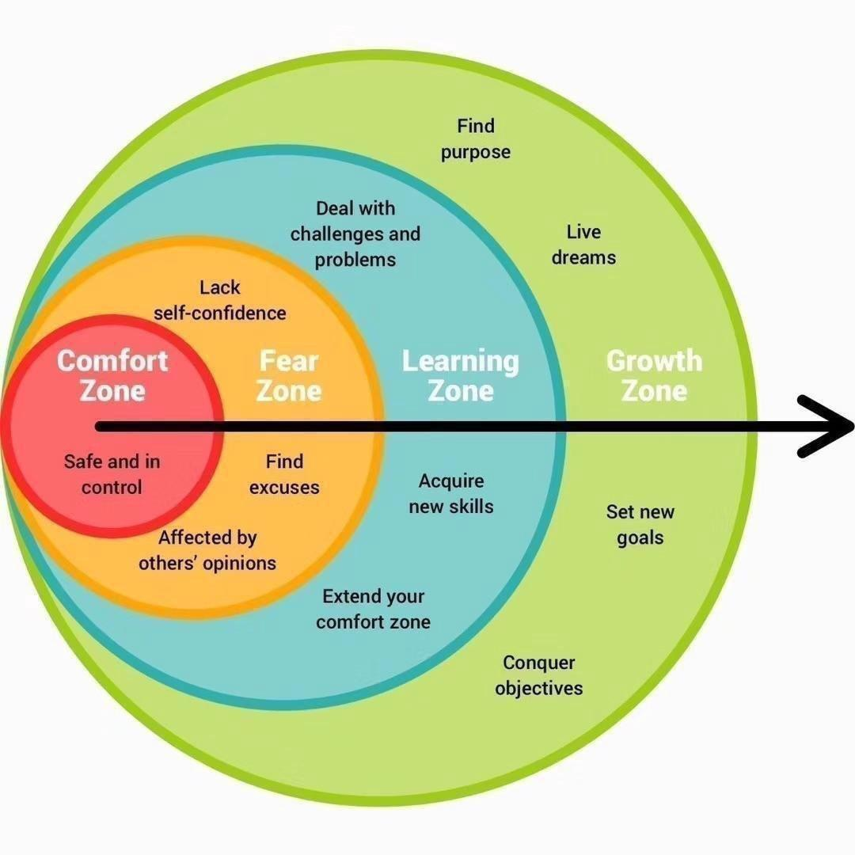
Move to functional
Are you safe and in control?

Slide 3
Move to functional
Agenda
Why?
Theory
Patterns
Snippets

Slide 4
Why?
Functional programming

Slide 5
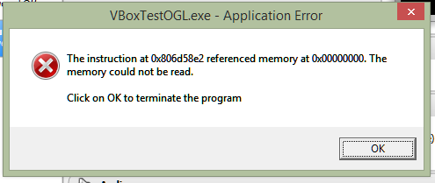
Move to functional
Why ? The billion dollar mistake
NULL
Tony Hoare invented the null reference in 1965
NULL, null, Nothing, nil, nullptr, undef, undefined, None, …
Client must check ALWAYS the return value …
… to avoid null reference exception

Slide 6
Move to functional
Why? IF and SWITCH … I love them… ☹
IF and SWITCH
Cyclomatic complexity is a software metric, used to indicate the complexity of a program.
It is a quantitative measure of the number of linearly independent paths through a program's source code.

Slide 7
Theory
Functional programming

Slide 8
Move to functional
Functions
Functions are first class citizen
You can assign a function to a variable
You can pass a function as a parameter of another function
You can return a function as a result of another function
High Order Functions

Slide 9
Move to functional
Immutability
Avoiding state mutation and shared state
Function “must” be pure
Deterministic
No side effect
Mutate global state, Mutates input arguments, Throw exception, Perform any I/O operation
Immutability
No race condition
Referential transparency (function can be replaced by its return value without change the program behaviour)

Slide 10
Move to functional
Functional programming paradigm
The imperative approach follows the principle of workflow control and answers the question ‘how to do’.
The declarative approach describes the data flow and answers the question ‘what to do’

Slide 11
Move to functional
Unit instead Void
Modelling the absence of data
Unit is a type to represent the absence of data (only one value exist for this type)
Void has a lot of problem because the compiler treat it as special value and we cannot write something like Func<Void>
Using Unit we can convert all the Action function into Func<Unit>
The use of void in the functions means we have function with side effect because they don’t return anything
Every functions should return a value and void is a type with zero values

Slide 12
Move to functional
Datatypes
A datatype is a an abstraction that encapsulates one reusable coding pattern.
Usually a data type is implemented by a struct
These datatypes are generalised by having one or several generic parameter

Slide 13
Move to functional
Option<T>
A datatype is a datatype that represents absence.
It is like a box containing or not the value
You can access the internal value using a Match function
The Some call back in case of value is present
The None call back in case of value is not present

Slide 14
Move to functional
Option<T>

Slide 15
Move to functional
Option<T>

Slide 16
Move to functional
Option<T> … use case

Slide 17
Move to functional
Either<L, R>
In the day by day work functions can fail, so we have to handle the errors
Either allows us to define two possible value for a function
The Right value when the computation is ok
The Left value in case of error

Slide 18
Move to functional
Either<L, R>

Slide 19
Move to functional
Either<L, R>

Slide 20
Move to functional
Either<L, R> … use case

Slide 21
Move to functional
Try monad
Try monad allow us to encapsulate into a function the exception handling
The Success value when the computation is ok without exception
The Exception value in case of exception
2019

Slide 22
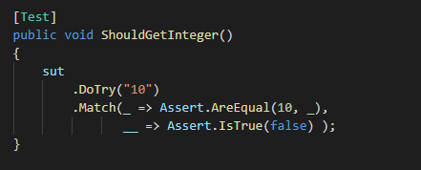
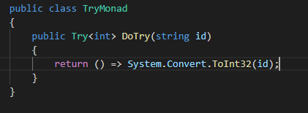
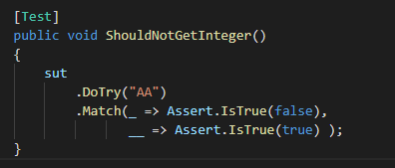
Move to functional
Try monad
2019

Slide 23
Patterns
Functional programming

Slide 24
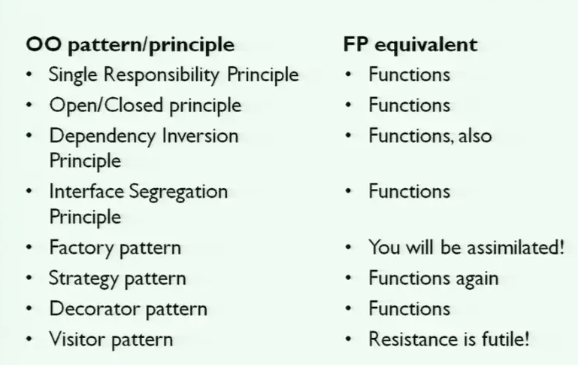
Move to functional
A lot of patterns…. ☺

Slide 25
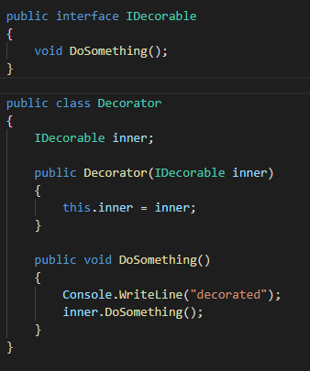
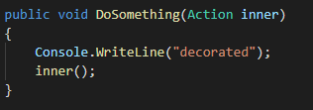
Move to functional
A lot of patterns…. Decorator using HOF

Slide 26
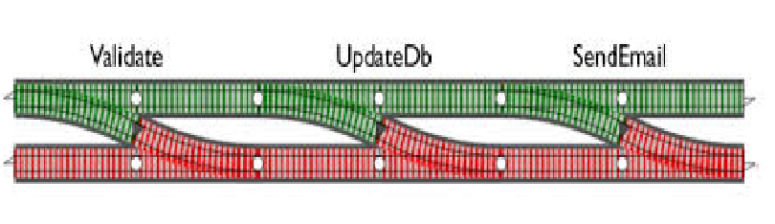
Move to functional
Railway pattern

Slide 27
Snippets
Functional programming

Slide 28

Move to functional
Snippets… language-ext
Don’t reinvent the wheel
Using the library language-ext https://github.com/louthy/language-ext

Slide 29
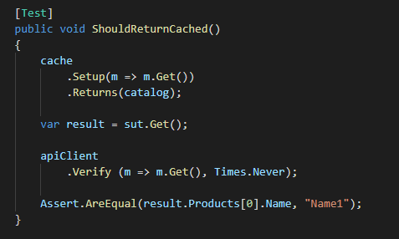
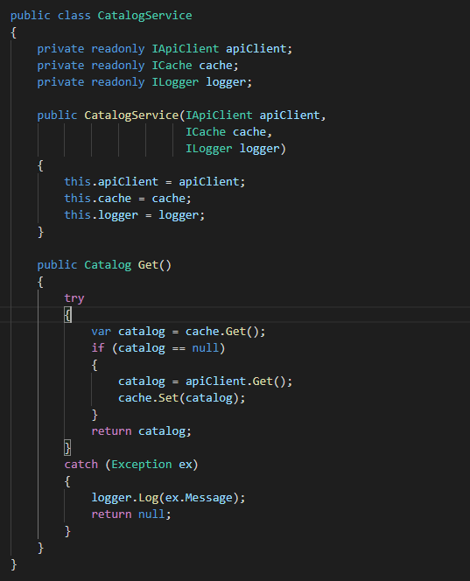
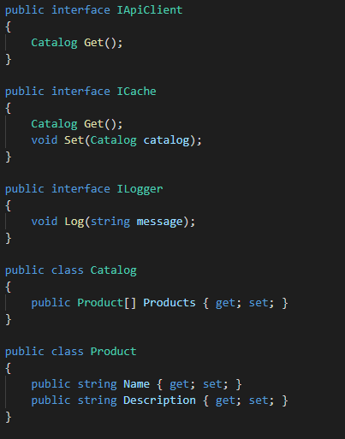
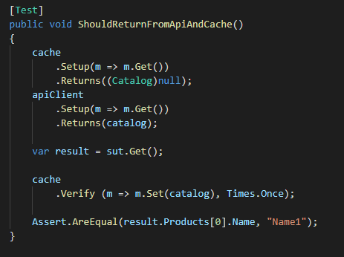
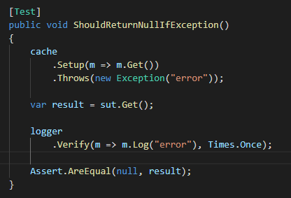
Move to functional
Get, Cache and Log

Slide 30


Move to functional
Get, Cache and Log

Slide 31
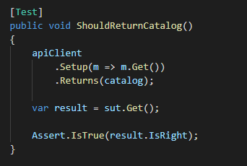
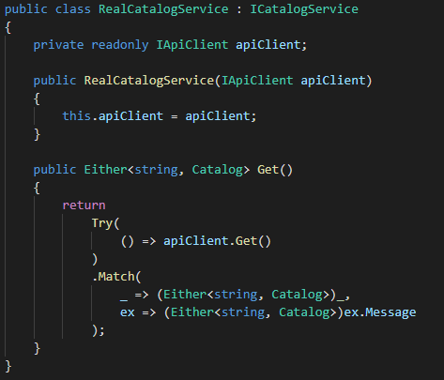
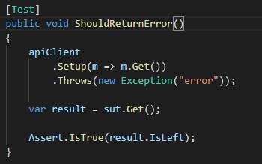
Move to functional
Get, Cache and Log…Decorating 1

Slide 32
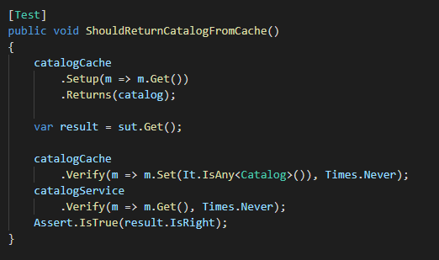
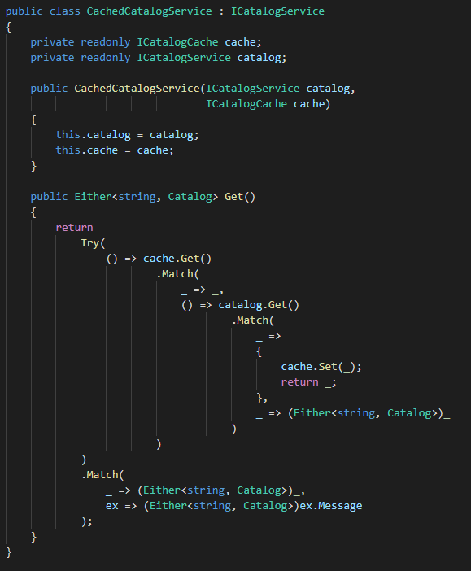
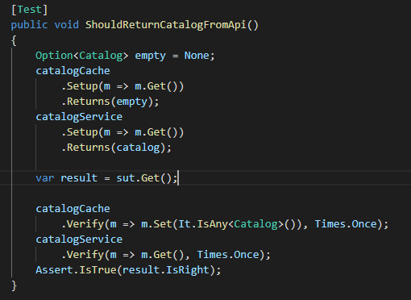
Move to functional
Get, Cache and Log…Decorating 2

Slide 33
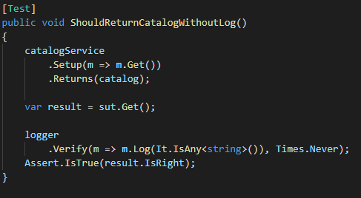
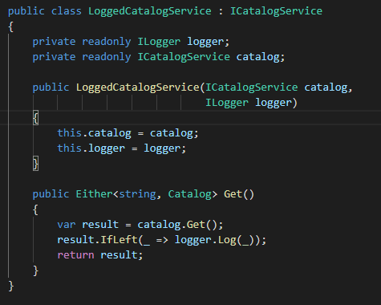
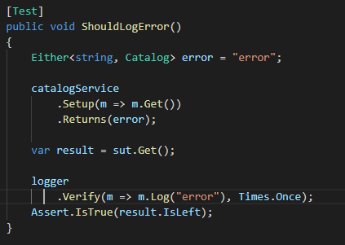
Move to functional
Get, Cache and Log…Decorating 3

Slide 34
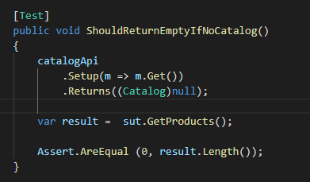
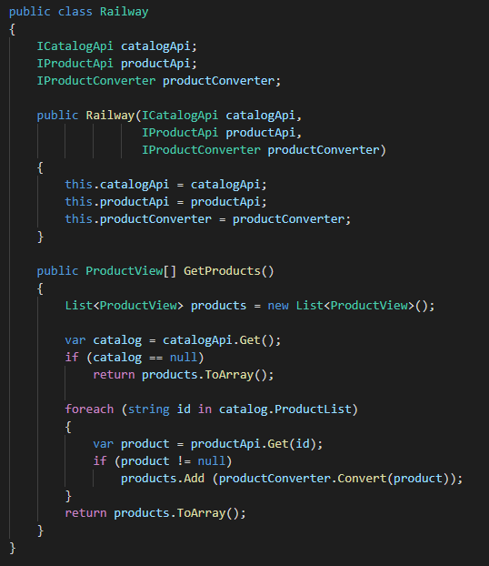
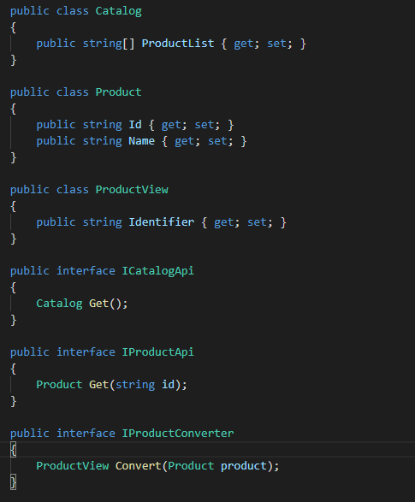
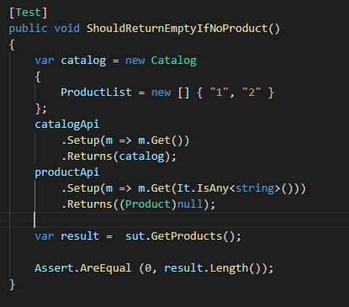
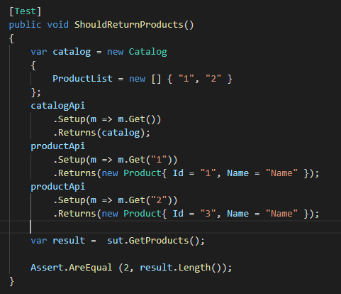
Move to functional
Get, Get, Convert and return (railway pattern)

Slide 35
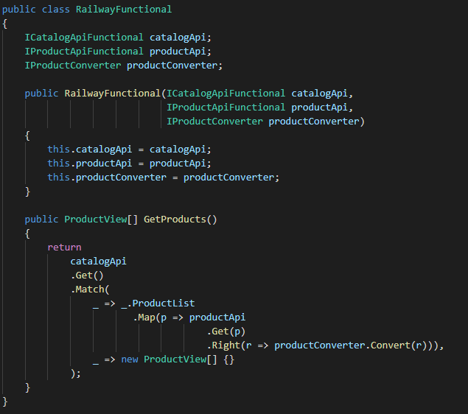
Move to functional
Get, Get, Convert and return (railway pattern)

Slide 36
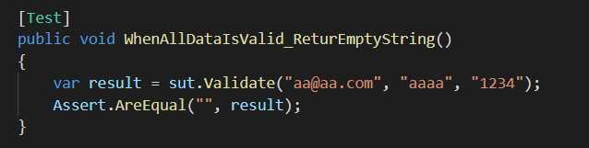
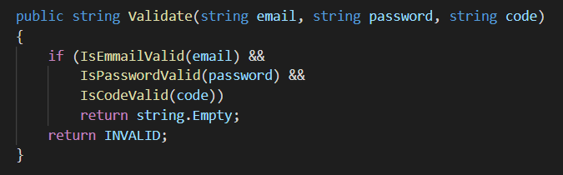
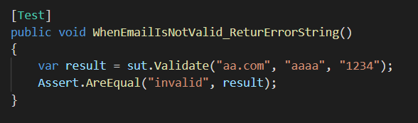
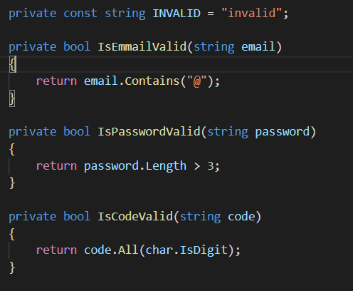
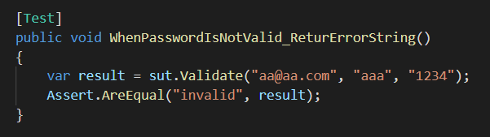
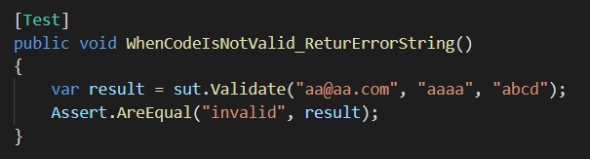
Move to functional
Validation … basic way

Slide 37
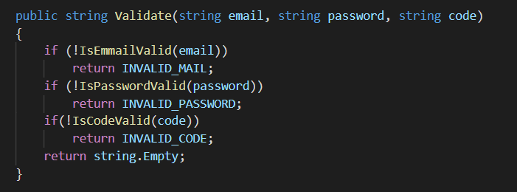
Move to functional
Validation … first improving

Slide 38
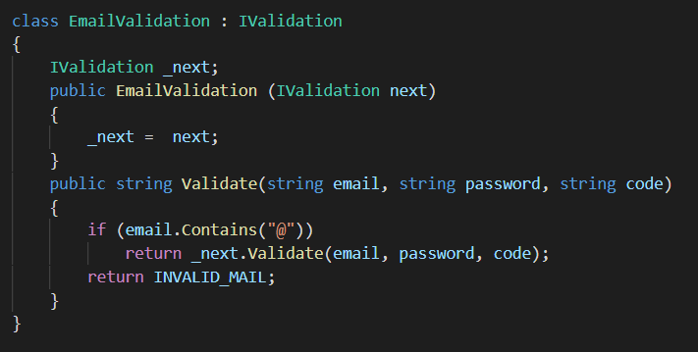
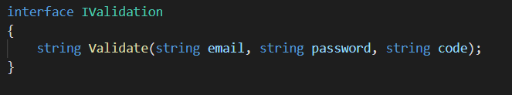
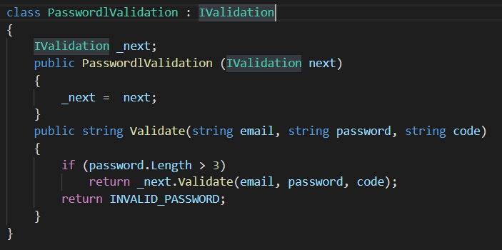
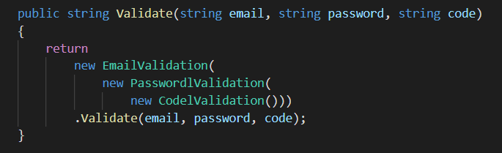
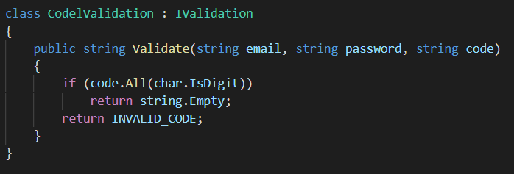
Move to functional
Validation … OOP Approach

Slide 39
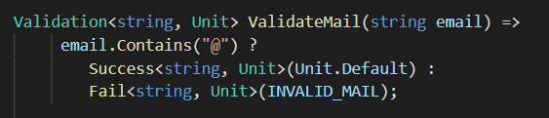
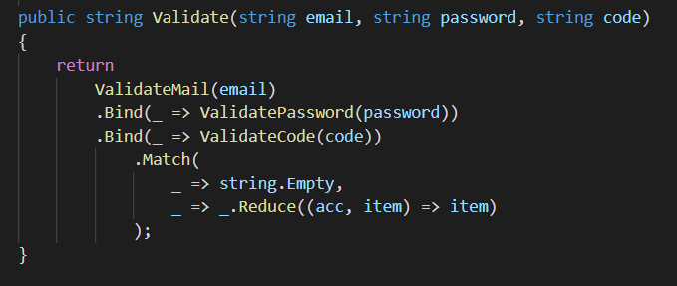
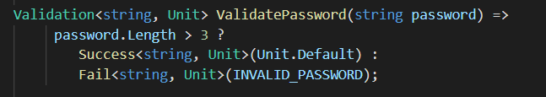
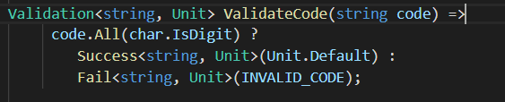

Move to functional
Validation … Functional approach using Applicatives

Slide 40
Thank you!

